Slide 1
Bluegrass Society for Human Resource Management: Legal Update

Slide 2
Drug Testing and Drug Policies in the Workplace
Kimberly J. O'Donnell

Slide 3
Introduction: Where are we Now?
Cannabis has long been heralded for its calming properties. But lately, it's having quite the opposite effect on HR professionals, as they navigate a myriad of state laws and court cases relating to drug testing.

Slide 4
Introduction: Where are we Now?
The most important takeaway from today's presentation on drug testing: possession or use of marijuana remains illegal under federal law.
Cannabis remains an illegal substance under the federal Controlled Substances Act.
Thirty-three states now allow medical marijuana use.
Eleven states (and Washington D.C.) allow recreational marijuana use: Colorado, Washington, Oregon, California, Nevada, Illinois, Michigan, Maine, Vermont, Massachusetts, Alaska.
About 66% of Americans favor legalizing marijuana—the highest measure in the last 50 years of polling.
About 24 million Americans ages 12 and older are current users of marijuana.

Slide 5
What about Kentucky?
Kentucky currently allows use and possession of CBD or low-THC products.
Shauna's Law—Senate Bill 83
Shauna's Law was named after Shauna Staton, a woman from Powell County, Kentucky who relies on cannabis to treat her chronic pain. Staton was a state employee who lost her job due to her use of CBD oil in treating her pain. Thus, Shauna's Law aims to protect workers who take CBD for medical reasons.
ONLY APPLIES TO PUBLIC EMPLOYERS.

Slide 6
What about Kentucky?
Medical Marijuana – House Bill 136 and Senate Bill 107
Forty-four of Kentucky's 100 representatives have sponsored House Bill 136 for the 2020 Legislative Session.
One-third of Kentucky's Senators have sponsored Senate Bill 107.
The House Bill's sponsor, Jason Nemes (R-Louisville) is "confident" the bill will pass the House this year.
Governor Beshear's position on medical marijuana:
"I support placing medical marijuana legalization on the ballot as a constitutional amendment and would vote in its favor. I would vote for it because I've seen the impact opioids have had on every Kentucky community. So many Kentucky families have seen a loved one fall into addiction, and their lives have been devastated. If medical marijuana is an alternative and gives people the chance to get pain relief without being subjected to opioids, I think it's something we've got to explore."

Slide 7
What about Kentucky?
While its overarching effect would be to legalize medical marijuana, HB 136 has some notable regulations and restrictions.
For one, the 160-page bill says that smoking medical cannabis would not be permitted.
Consumption could take place through the form of pills, capsules, oils, inhalers and edibles, which must not be "attractive" in any way to children.
The bill also lists "qualifying medical conditions" with "chronic or debilitating" effects that could be treated with medical marijuana, including opioid use disorder, PTSD, epilepsy, AIDS, and glaucoma. However, the list could be expanded to other diseases or medical conditions that a medical practitioner "determines to be severe and resistant to conventional medication."
The intent of the regulations, the bill's sponsor has said, is to avoid the overprescribing and drug abuse that have characterized the opioid crisis.
Under the bill, users with an order from a licensed physician would receive a "registry identification card" from a "department of alcoholic beverage and cannabis control" in order to obtain medical marijuana from a regulated dispensary.

Slide 8
What about Kentucky?
Recreational Marijuana—House Bill 148
Howard's bill would decriminalize the possession of less than 1 ounce of marijuana and allow those previously convicted of marijuana-related misdemeanors to have their offense expunged for free.
Permits to grow cannabis plants at home also could be purchased for $250 per year under the bill.
Unlikely to pass in 2020.

Slide 9
Drug Policies and Drug Testing
Hypothetical: How would you suggest workplace drug policies change if medical marijuana is legalized in Kentucky?

Slide 10
Drug Policies and Drug Testing
Consensus on how much THC is too much?
The federal rules set .04 percent blood alcohol readings as a violation for workers in jobs such as driving trucks or forklifts.
Private companies generally use a range somewhere between .02 and .04 percent.
Proper Drug Testing Policies
Workplace drug testing policies are important to maintain an effective and drug free workplace. A good policy will improve safety, aid the company in adhering to OSHA and ADA requirements, improve employees' performance, and mitigate workers' comp issues.
Most industries are not required to drug test their employees; however, federal law requires employers to test employees in transportation and aviation industries, Department of Defense contractors, and NASA contractors. Kentucky requires drug and alcohol testing for employees in the transportation and mining industries.

Slide 11
Drug Policies and Drug Testing
Do we need to test for marijuana?
Last year, Caesars Entertainment stopped marijuana screening for prospective employees
Apple used to test all prospective employees, but now tests only those applying for jobs with safety risks
Manufacturing employers may see things differently than service-industry employers

Slide 12
Drug Policies and Drug Testing
Should an employer have a "Zero-Tolerance" Policy?
Discussion—what problems could you foresee with such a policy?
When Should an Employee be Tested?
When there is reasonable suspicion of prohibited alcohol or drug use.
After an accident on the premises or in the course of employment.
Considerations when Testing
Disability discrimination – If the applicant is prescribed medications for a disability protected by the ADA and those medications appear on the person's drug test, you cannot punish the person.
Discrimination – Do not single out a certain group of employees for drug testing (i.e. age, race, gender).

Slide 13
Employer Best Practices for HR with Respect to Marijuana Use
Don't tolerate marijuana use on the job, just as you wouldn't tolerate alcohol use.
Train managers to spot signs of impairment.
Think carefully about the type of test your company uses and stay on top of developments in the technology of testing.
Talk to a lawyer about relevant state laws before setting policies or testing rules.
For companies operating in different states, know that testing policies may vary by location.
Educate employees about the company marijuana-use policy and the repercussions for failed tests, including random, post-accident or reasonable-suspicion tests.

Slide 14
Impacts of CBD on Drug Testing and Legalization of Marijuana on Employer Policies
What is CBD?
A legal substance derived from hemp.
Used to treat numerous ailments from body pain to insomnia.
Contains no more than 0.3% THC, by definition. THC is the ingredient in marijuana that gives it its psychoactive effects.
There is minimal regulation of CBD oil. A study by the Journal of the American Medical Association showed that 45% of CBD oils they tested contained more THC than was on the bottle label.
Drug tests do not indicate whether a positive THC test is from CBD oil or cannabis.
The amount consumed, the frequency of use and an individual's metabolism of the product impacts whether the person will test positive for THC.
Because Kentucky has not legalized medical marijuana, employers with zero-tolerance drug policies are free to discipline employees for failing drug tests, including those that test for THC.
Some states that have passed medical marijuana laws have also passed state law protections for their citizens who legally use medical marijuana.

Slide 15
Impacts of CBD on Drug Testing and Legalization of Marijuana on Employer Policies
Hypothetical: An employee goes to Colorado for the weekend and smokes marijuana, where recreational marijuana is legal, and returns to Kentucky and drug tests positive.

Slide 16
Prescription Drug Policies
Hypothetical: Can a person on prescription drugs for a condition protected by the ADA be moved to a different position if the medication is known to have adverse side effects that could cause a safety concern?

Slide 17
Prescription Drug Policies
Employers should put in their company drug policy that employees using prescribed medication that could impair his or her physical, mental, or emotional faculties must immediately report the treatment to his/her supervisor.
You cannot require employees to report all medications they are taking.
Can only make a medical inquiry when the employer is able to demonstrate that an employee is unable to perform the job's essential functions because of a medical condition or the employee will pose a direct threat to himself/herself or to others because of a medical condition.
Must show a significant and current risk of substantial harm.
Cannot be based on speculation. Must be based on objective medical or other factual evidence regarding a particular individual.
Even if the employer determines that a significant risk of substantial harm exists, the employer needs to consider whether the risk can be eliminated or reduced below the level of a direct threat with a reasonable accommodation.

Slide 18
Prescription Drug Policies
Effect of Employee in a Safety Sensitive Position
Safety-sensitive positions are those that are routinely performed as part of the position which could reasonably be expected to affect the health, safety, and security of others.
Examples include:
school bus drivers
school bus mechanics
people with direct involvement in a recipient's trip, including:
scheduling,
dispatching,
driving, or
maintaining the vehicle fleet
heavy equipment operators
employees with a CDL
mechanics working on CDL regulated vehicles
More likely to meet the threshold to show that a direct threat exists.

Slide 19
Travel Time
Sarah Laren

Slide 20
Travel Time
The FLSA requires employers to compensate employees for all hours worked and pay them 1.5 times their wage for all hours over 40 worked per week
Does travel time count as "hours worked"?
29 C.F.R. 785.33 through 29 C.F.R. 785.41 provide guidance on this issue
Ordinary home to work travel – Not compensable
Exception: Traveling from home to a customer's workplace in an emergency situation
Same day out-of-town travel – Compensable if it is done at the employer's request and is integral to the principal activity the employee is hired to perform
Travel that is "all in a day's work" – Compensable if it is part of the employee's principal activity (i.e., travel from job site to job site, reporting in at office before traveling to job site)
Overnight out-of-town travel – Compensable if it cuts across the normal work day (or working hours on a non-work day)

Slide 21
Travel Time
2018 DOL Opinion Letter—How to assess travel time for employees who have no normal working hours?
Three options:
Review work records to find "typical work hours" during the most recent month of employment;
If the employer is not able to determine the employee's typical work hours, determine the average start and end times for that month; or
If the employee truly has no normal work hours, negotiate and agree with the employee as to a "reasonable" amount of compensable travel time
State laws may have additional requirements (ex. California)
Employer must have protocols for recording travel time and instruct employees accordingly

Slide 22
Travel Time
Hypothetical: An employer in Kentucky asks two nonexempt employees who work 9-5 M-F to travel to Tennessee on a Friday morning to work a daytime event. Is the time spent traveling to Tennessee compensable?
Suppose that the employer also maintains an office in Tennessee, and the Kentucky employees have to stop there and pick up supplies before proceeding to the event. Can they count the time spent going from the Tennessee office to the event as compensable travel time?
Suppose that the event occurs on Saturday. The employees are driving down during the work day on Friday, then traveling home on Saturday after the event ends at 3 p.m. Is the travel time compensable?
Suppose that the employees want to drive an hour out of the way and stop at an outlet mall on the way home. Is the travel time compensable?

Slide 23
Service Animals v. Emotional Support Animals in the Workplace
Elizabeth Lampert
A dog, a miniature horse, and a peacock walk into a bar…

Slide 24
Service Animals v. Emotional Support Animal Categorization
Service Animal – ADA
An animal that has been trained to perform specific tasks for the benefit of an individual with a physical or mental disability.
Covered under the ADA.
Emotional Support Animal
Has not been trained for a specific task; only provides emotional support or comfort.
Not covered under the ADA.
A doctor's note does not make an emotional support animal a service animal.

Slide 25
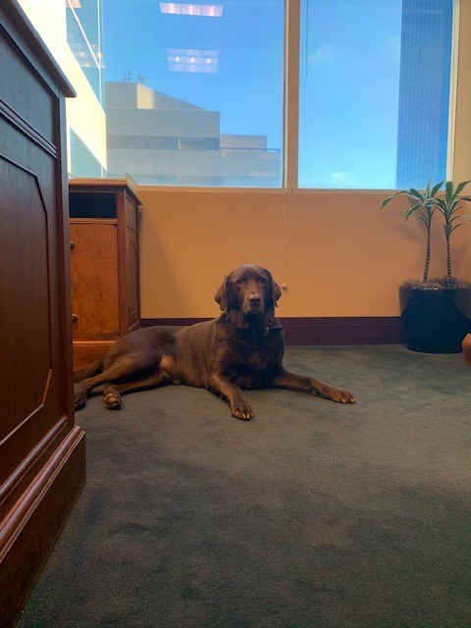
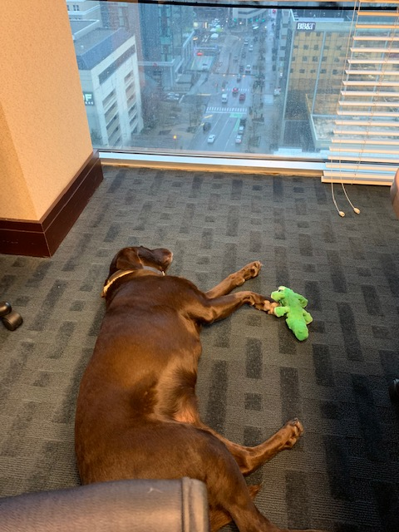

Slide 26
ADA Process
Applies to employers with 15 or more employees, federal agencies, and any program or entity receiving federal financial assistance.
Do you have a no-animals policy?
If not, the animal will already be permitted.
Is the employment such that the no-animals policy can be amended?
If the policy can be modified, ask for medical documentation if the disability and need for accommodation are not obvious or already verified.
Employers can ask the specific task the dog has been trained to perform, for documentation that the animal has been trained, and that the animal is necessary. Employers cannot ask for a demonstration.

Slide 27
Reasonable Accommodation
Under the ADA, employers must provide reasonable accommodation to employees with disabilities unless it would impose an undue hardship on the employer or a direct threat in the workplace.
The employer does not have to provide an accommodation that poses an undue hardship.
Reasonable accommodation: a change to how a job is completed that does not cause undue hardship on the employer but allows the individual to perform all the essential functions of a job effectively

Slide 28
Reasonable Accommodation
Not an automatic requirement under the ADA that an employee allowed to bring a service animal into the workplace. The request must be handled as any other request for accommodation made under the ADA.
Allergies and fear of dogs.

Slide 29
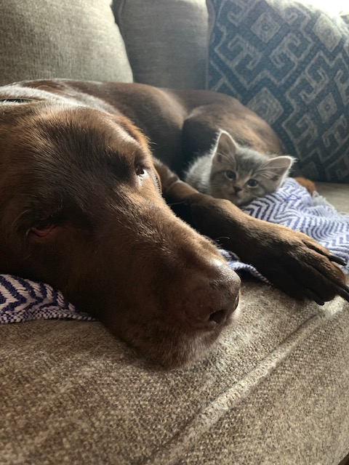
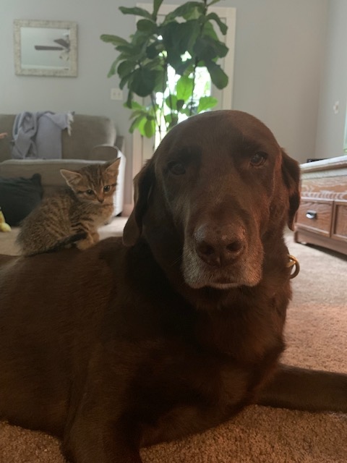

Slide 30
Emotional Support Animals
Treat like an ADA request.
Ask for documentation and an explanation of how the accommodation of allowing the animal would help the employee perform his/her job.
If there are other accommodations that could have the same effect but cause less disruption, such as additional breaks, the employer can deny the specific emotional support animal request by implementing an alternate accommodation.
Allow on a trial basis.
Written agreement
Determined length of time
Things may make the trial period end early

Slide 31
Hypothetical
Can an operating room nurse bring an emotional support dog to work with him if the hospital has a no-animal policy?

Slide 32
Devices in the Workplace
Sarah Laren

Slide 33
Devices in the Workplace
Allowing personal devices in the workplace can lower overhead, improve efficiency, and provide flexibility for employer and employee
However, they can present data security and FLSA problems
A good BYOD Policy can reduce or eliminate these risks by creating consistency and clarity and addressing issues before they arise
State the purpose of the policy
Identify approved devices
Define acceptable use
Set reimbursement figure
Specify level of technical support to be provided
Discuss expectations of privacy
Set protocols for protection of company data in the event of loss, theft, security breach, and termination

Slide 34
Devices in the Workplace
Special Considerations:
Hourly employees
Do they really need to use a personal device for business purposes?
If so, carefully specify when work can be performed by hourly employees (otherwise, creates a risk of uncompensated/overtime work)
Independent contractors
Including them in the Policy them makes them look like employees

Slide 35
Devices in the Workplace
Hypothetical: Employer discovers that an employee, who is subject to a BYOD Policy with the elements previously discussed, is using his personal cell phone to send confidential Company material from the Company’s database to his personal Cloud storage account. How may the employer handle?

Slide 36
Questions? Just ask! Or contact us…
Kimberly J. O'Donnell
Partner
Labor & Employment, Appellate Advocacy
+1 859 288 4696 kim.odonnell@dentons.com
Sarah T. Laren
Managing Associate
Litigation, Labor & Employment
+1 859 288 4635 sarah.laren@dentons.com
Elizabeth A. Lampert
Associate
Economic Development
+1 859 288 4637 elizabeth.lampert@dentons.com

Slide 37
Thank you
Dentons Bingham Greenebaum LLP 300 West Vine Street
Suite 1200
Lexington, KY 40507
(859) 231-8500
Dentons is the world's largest law firm, delivering quality and value to clients around the globe. Dentons is a leader on the Acritas Global Elite Brand Index, a BTI Client Service 30 Award winner and recognized by prominent business and legal publications for its innovations in client service, including founding Nextlaw Enterprise, Dentons' wholly owned subsidiary of innovation, advisory and technology operating units. Dentons' polycentric approach, commitment to inclusion and diversity and world-class talent challenge the status quo to advance client interests in the communities in which we live and work. www.dentons.com.
© 2020 Dentons. Dentons Bingham Greenebaum is a member firm of Dentons. Dentons is a global legal practice providing client services worldwide through its member firms and affiliates. This publication is not designed to provide legal advice and you should not take, or refrain from taking, action based on its content. Please see dentons.com for Legal Notices.

